Slide 1
Ya gotta make it obvious
Terence Parr
MSDS program University of San Francisco

Slide 2
Most…
Kathleen Fisher: "Hit people over the head with it!"
Half the human cortex is devoted to understanding our world visually
Should leverage that to understand, describe, and debug computational abstractions, such as machine learning models
Often represents considerable extra effort, particularly animations
We all have the urge to impress rather than illuminate
Can lead to papers, lectures, and classes that don't actually transmit ideas to others
We should value simple and clear expositions most of all, making the key ideas obvious, even if it requires extraordinary effort
We should not accept the status quo, and constantly ask ourselves if these are the best explanations and visualizations we can make
state-of-the-art visualizations from https://explained.ai

Slide 3
Sometimes you are right and everyone else is wrong, particularly blogs on the net
be skeptical; Question everything; MAPE, ROC, log loss
Automate so that you can keep using the visualization: be good to your future self!
Don't start with the math (the solution); re-drive everything. Neg log loss a good one
Strive to understand everything deeply so that you can find the key not in order to describe it
Took me a year to get the regularization picture
Implement if you want to understand; Feynman quote
Look for the pain; then ease your pain. Build things you will use which means others will find it useful
Can't create what you can't imagine
Don't be guided by what is possible or what you know how to build; should for the best possible viz you can think of
Be tenacious! Never let the computer win
Experiment/explore. Don't know what is good until you see samples
Sometimes solving a programming problem is less about algorithms and more about working within the constraints and capabilities of the programming ecosystem, such as tools and libraries. Dtreeviz Generating high quality vector-based images also required pathological determination and a trail of dead code left along the circuitous path to success.

Slide 4
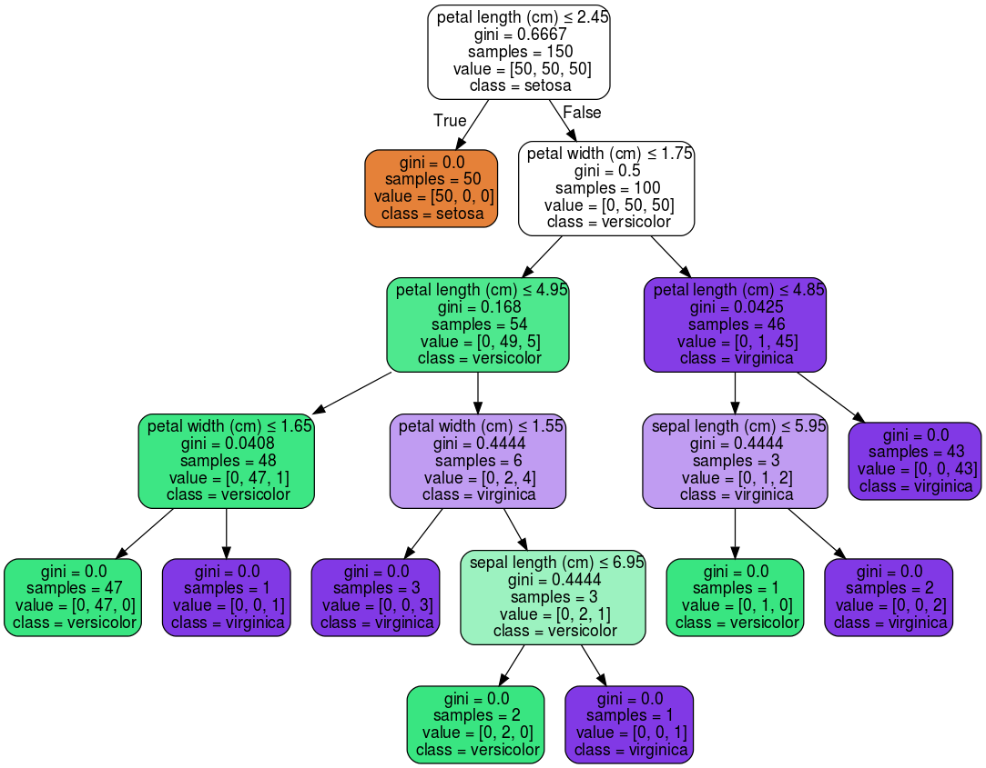
Ask why or how it's doing that
Decision tree classifier for the toy iris data set
This shows the tree structure, which variable and split point tested at each node
What does color mean?
What's it missing? It's missing why the split occurs where it does
Is more info always better? Sometimes better to give less but better focused.

Slide 5
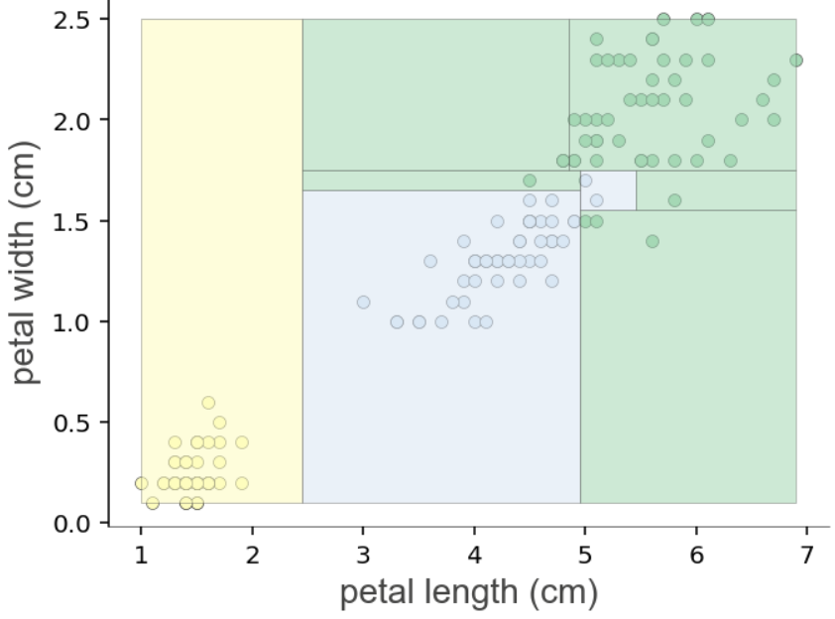
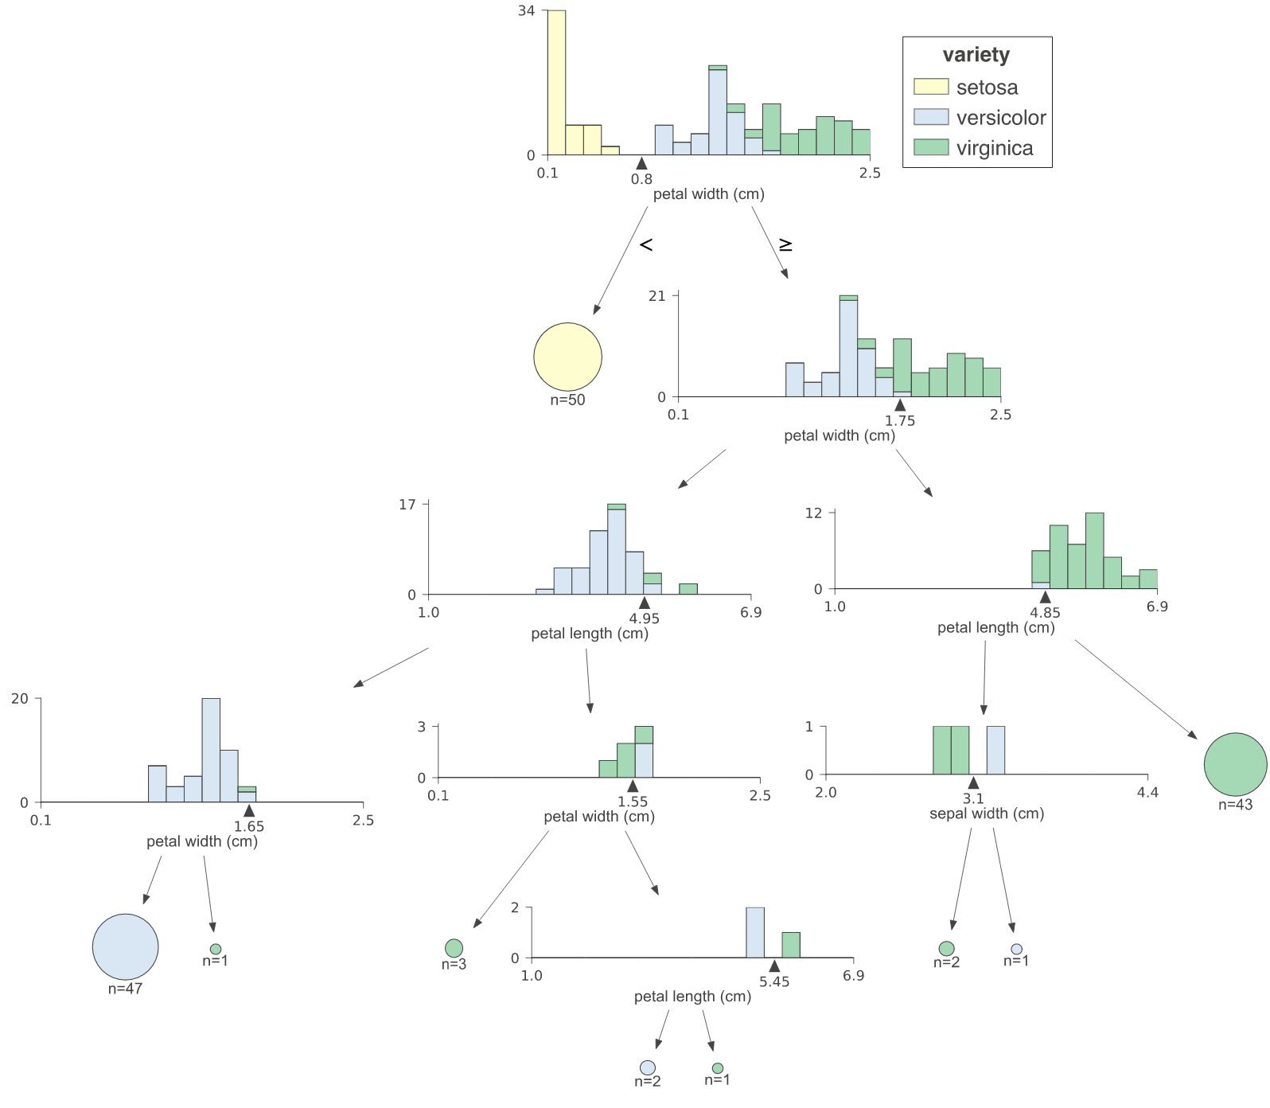
Ask why or how it's doing that

Slide 6
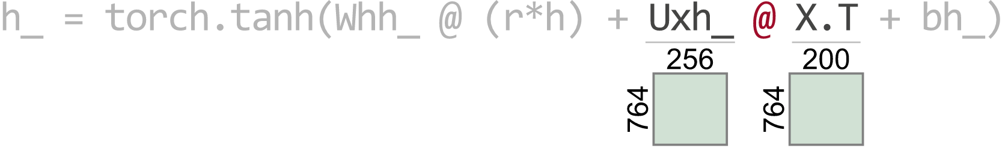
h_ = torch.tanh(Whh_ @ (r*h) + Uxh_ @ X.T + bh_)
RuntimeError: size mismatch, m1: [764 x 256], m2: [764 x 200] at /tmp/pip-req-build-as628lz5/aten/src/TH/generic/THTensorMath.cpp:41
Cause: @ on tensor operand Uxh_ w/shape [764, 256]
and operand X.T w/shape [764, 200]

Slide 7
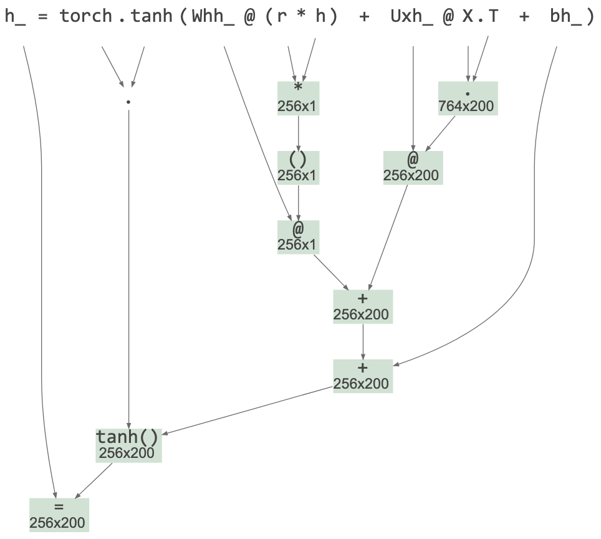

Slide 8
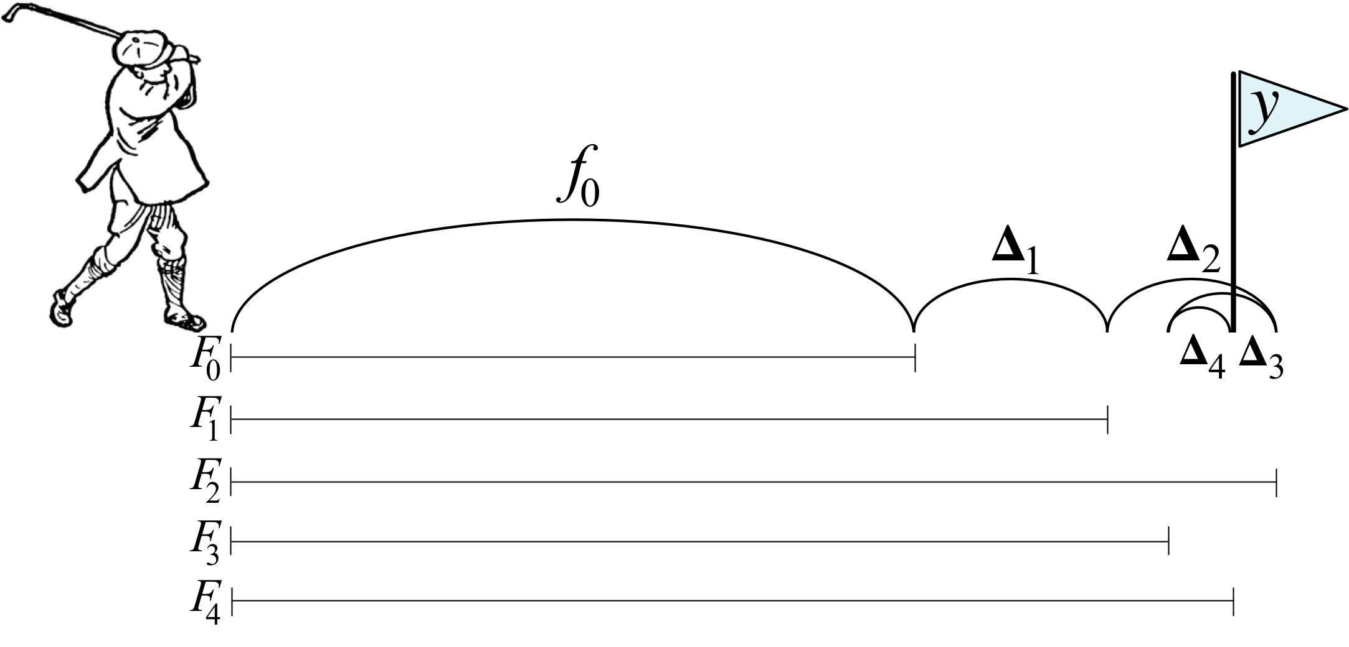
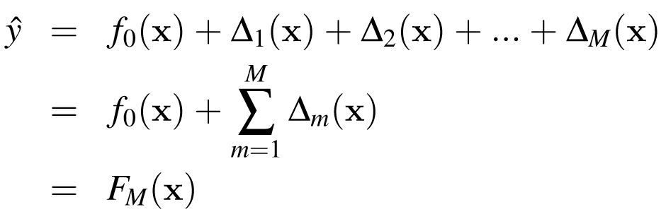
explaining gradient boosting
boosting as an additive model
So show that and the nature of the individual nudges; think of an analogy all it took was a golfer icon

Slide 9
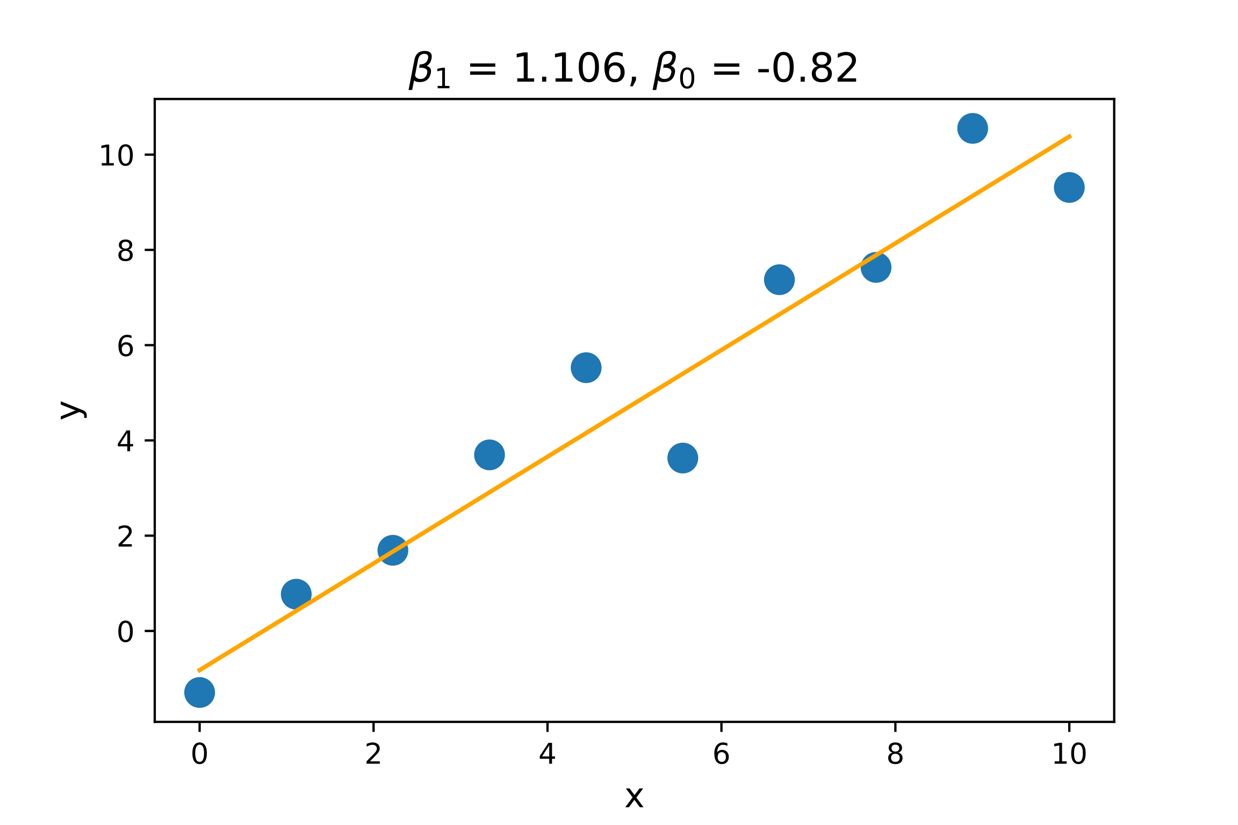
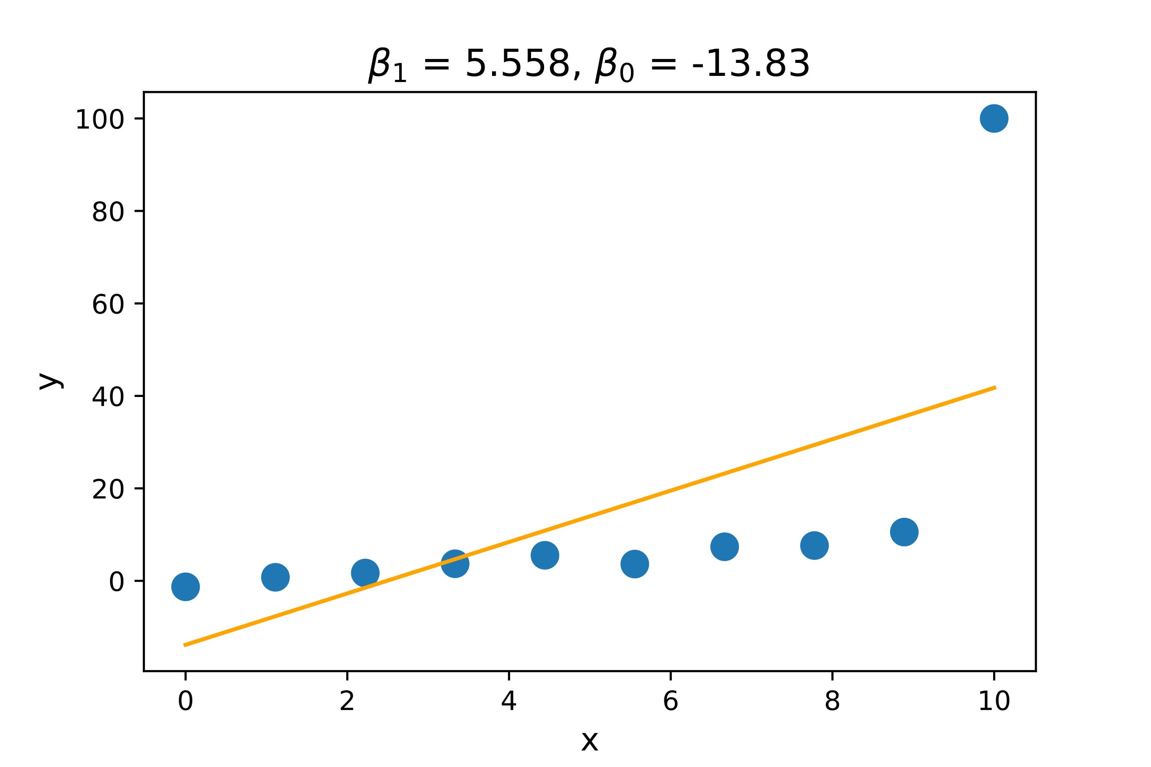
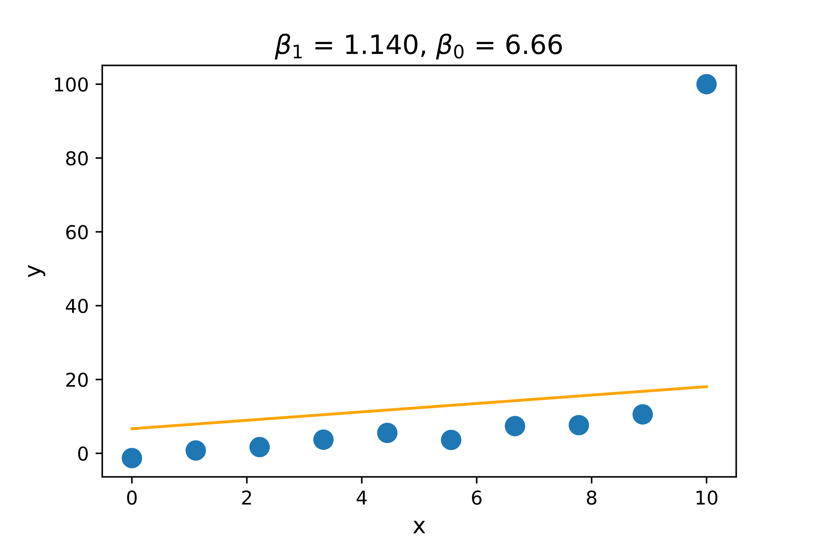
Explaining regularization of linear models
Don't start with the math; motivate!
Extreme coefficients are unlikely to yield good generalization, so constrain model coefficient magnitudes
Let’s trade some model bias (accuracy) for improved generality
Ordinary least squares
OLS with outlier
L1 regularization with outlier
Outlier

Slide 10
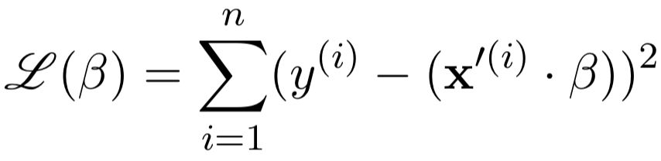
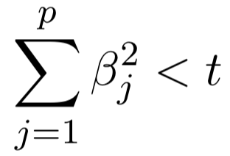
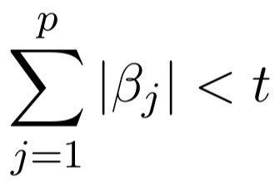
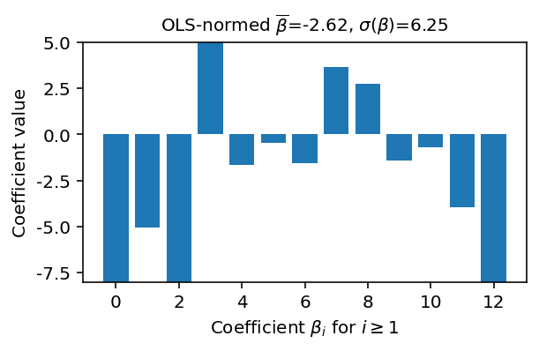
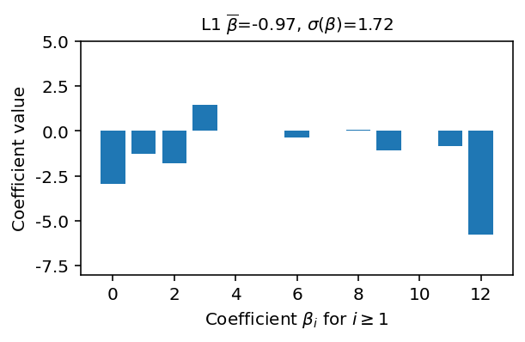
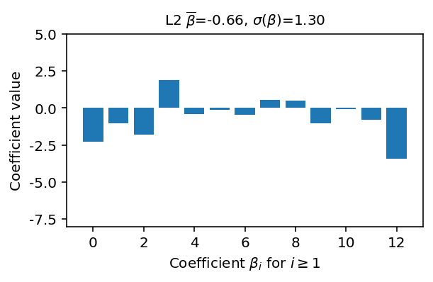
Demonstrate effect of regularization
or

Slide 11
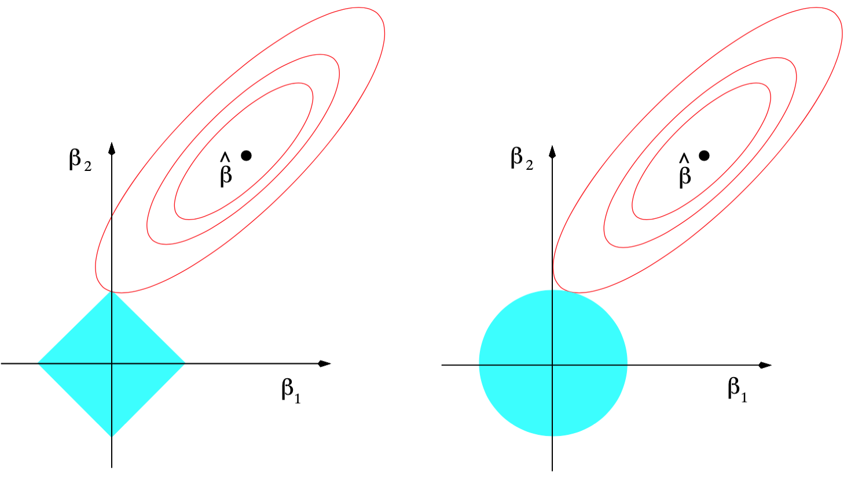
Most common student question: why does L1 give more zero coefficients?
L1 regularization (lasso)
L2 regularization (ridge)
Fig 3.11, Page 71 Elements of Statistical Learning

Slide 12
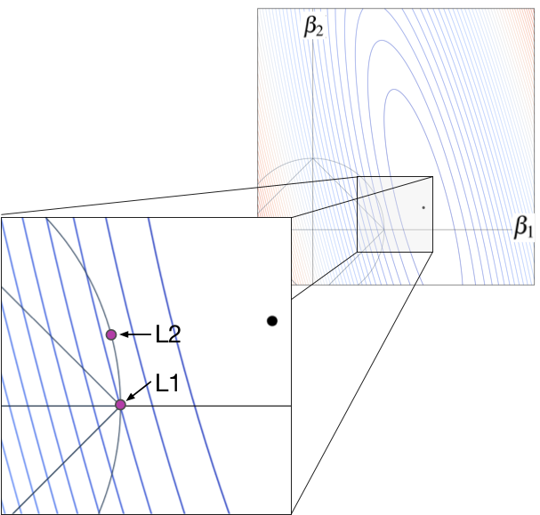

Slide 13
dfsd

Slide 14
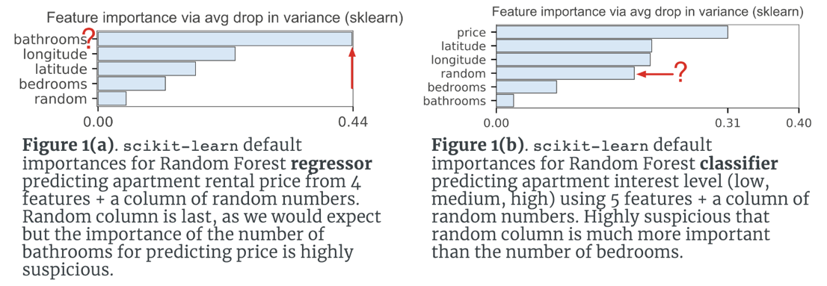
be skeptical
sometimes everybody else is wrong
MAPE? ROC?

